Slide 1
Data Scientist – Vidio Question 3
Created by Fuad Maulana

Slide 2
The Question
What kind of tools that you use to work on this dataset?
Explain why and describe the significant advantage of that tools.

Slide 3
Tools Used For Vidio Dataset
The tool that can be used for this dataset is Python using Jupyter Notebook. This is because Python has a simple structure and is open source, making it easy to develop a program that will be created. Python also has many libraries that make it easy to program. Therefore, Python can perform several processes on this dataset such as data cleaning, data mining, and data visualization. Jupyter Notebook has advantages in data visualization over other IDEs. But a good tool for visualization is Tableau.

Slide 4
Data Cleaning
Python makes it easy in data cleaning process to prepare data properly which will then be used in data processing. There are libraries that facilitate data cleaning process, namely pandas and numpy libraries. Pandas library makes it easy to clean data on the dataframe, while numpy library makes it easy for mathematical processes such as large multidimensional sets and matrices.

Slide 5
Data Cleaning Example
Drop unnecessary column, like column city
=> df.drop([“city”], inplace=True, axis=1)
Changing index with unique column, like column hash_content_id
=> df.set_index(“hash_content_id”, inplace=True)
Dropping NaN values
=> df1.dropna()
Split and Add column, like column play_time (format=Year-Month-Day-Hour-Minute-Second) to column date_play (format=Year-Month-Day) and time_play (format=Hour-Minute-Second)

Slide 6
Data Mining
In data processing, Python can facilitate the process by using several libraries such as scikit-learn, keras, and tensorflow. Data mining is carried out in this dataset such as Exploratory Data Analysis (EDA) ana Machine Learning Modeling. EDA is carried out such as knowing the relationship between video categories and videos that are watched to completion or not, finding the number of visitors who watch the most videos, knowing patterns from users, and so on (such as the process in Question 1, 4, and 5). The data modeling can be in the form of classification of premium video content or not, classification of videos that are of interest and not, and so on using machine learning.

Slide 7
Data Visualization
Python can present the results of data processing in the form of good visualizations such as charts. Of course, in conveying insight or information from processing the dataset, it needs to be presented in a good visualization form so that it can be easily understood by many people.

Slide 8
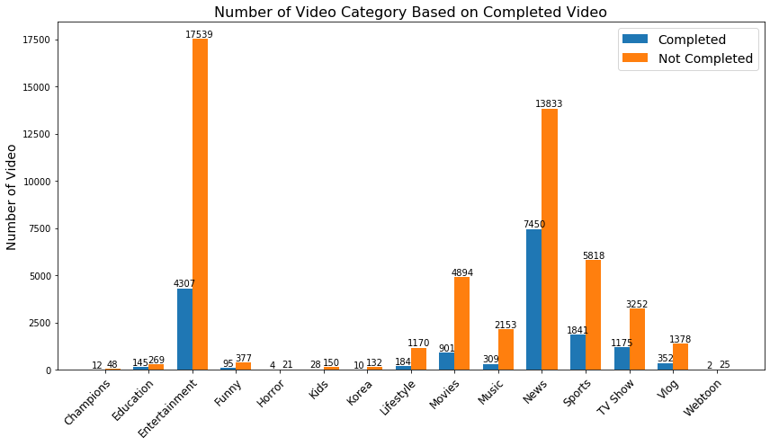
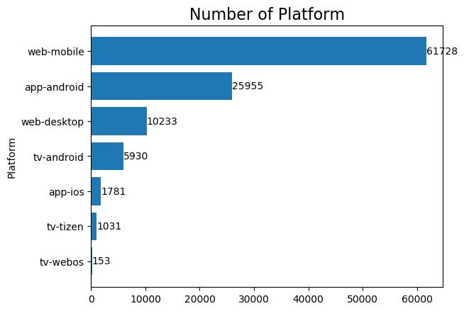
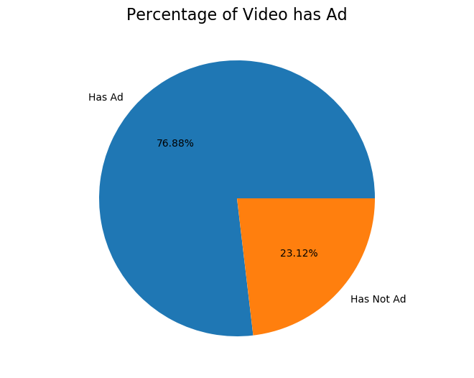
Data Visualization Example

Slide 9
Data Visualization With Tableau
In addition to using Python, Tableau has a better advantage in visualizing that data. Interactive visual options, user friendly, can process multiple data sources, mobile friendly dashboard, and can use filter to find information that we want. To display information in a good visualization, then Tableau is better than Jupyter Notebook.

Slide 10
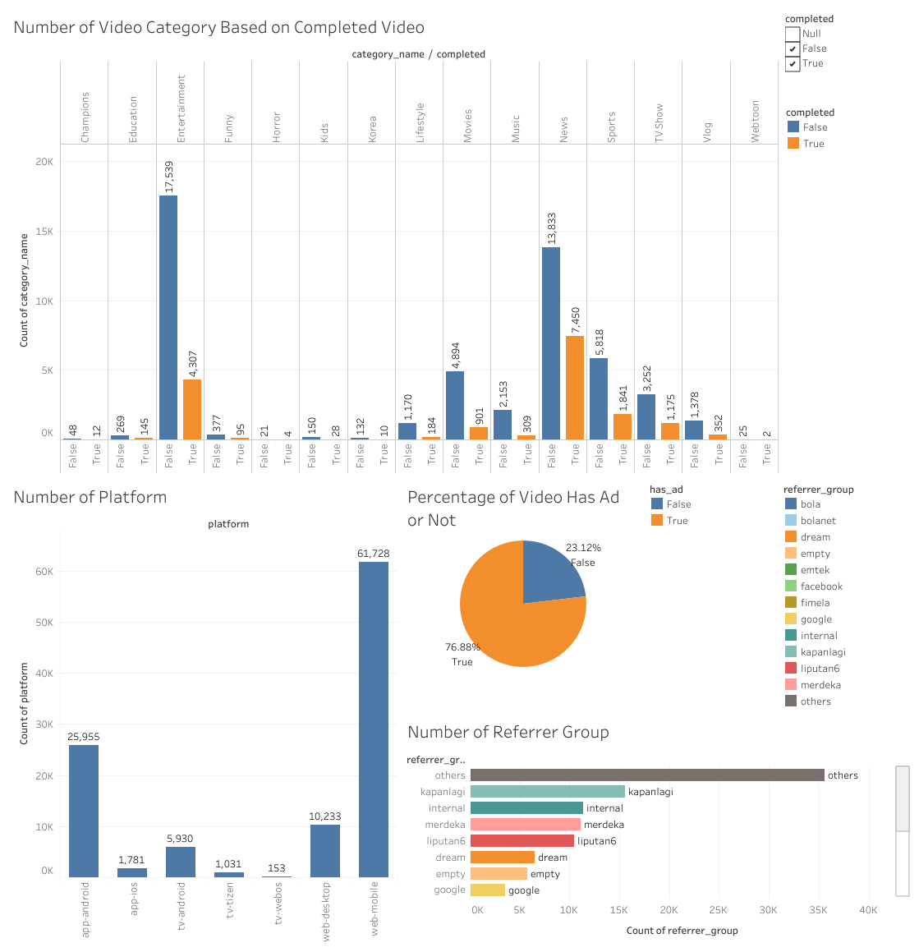
Tableau Example
Source : https://public.tableau.com/views/vidio_fuad-maulana_question_3/DashboardVidio?:language=en-US&publish=yes&:display_count=n&:origin=viz_share_link

